Slide 1
Hydrating the Data Lake

Slide 2





























Session’s Focus – Working In The Data Lake
Amazon
Amazon Elasticsearch
AWS
Glue
AWS
AppSync
Amazon API Gateway
Amazon Cognito
DynamoDB Service
Access & User Interfaces
Catalog & Search
Central Storage
Scalable, secure, cost- effective
Amazon Athena
Amazon EMR
AWS
Glue
Amazon Redshift
Amazon DynamoDB
AWS
Snowball
Amazon Kinesis Data Firehose
AWS Direct Connect
AWS Database Migration Service
AWS Storage Gateway
S3
Manage & Secure
Amazon QuickSight
Amazon Kinesis
Amazon Elasticsearch Service
Amazon Neptune
Amazon RDS
AWS
DataSync
AWS Transfer for SFTP
Amazon S3 Transfer Acceleration
Analytics & Serving
AWS KMS
AWS IAM
AWS
CloudTrail
Amazon CloudWatch
Data Ingestion

Slide 3
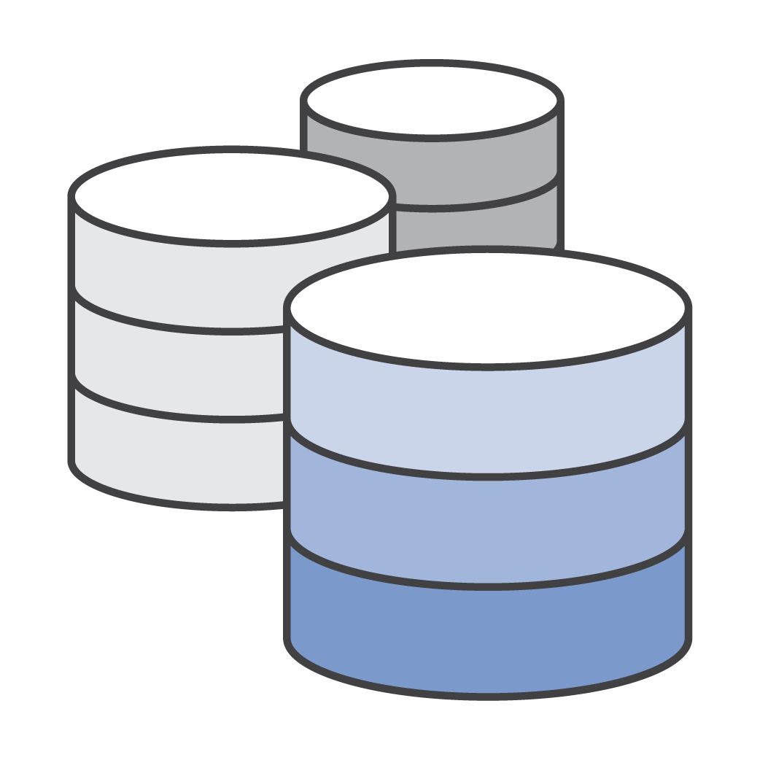



Data Sources
Databases
Streams
Logs
Files

Slide 4

Data Sources - Databases
Databases
Amazon S3

Slide 5
Change Data Capture
Techniques to Capture Changes
Timestamp
Diff Comparison
Triggers
Transaction Log

Slide 6












Change Data Capture – Timestamp
4/18/18 300
3/12/18 800
9/25/17 230
2/04/18 100
4/18/18 300
Kinesis Data Firehose
Amazon S3
11/10/20 1600
Last Run: 11/10/20 1400
9/25/17 230
2/04/18 100

Slide 7







Change Data Capture – Diff Compare
6/15/18 0300
20180615T0300
Diff Compare
Kinesis Data Firehose
Amazon S3
6/16/18 0300
20180616T0300

Slide 8



Change Data Capture – Triggers 1/2
SELECT
Id: 20982358
Name: Jean-Luc Picard Rank: Captain
State: Agitated
Write operations to Firehose
Table: Roster Id: 20982358
Operation: Update Job: ag8afh8
Kinesis Data Firehose
Amazon S3
SELECT
Table: Roster
Id: 20982358
Operation: Update

Slide 9
Change Data Capture – Triggers 2/2
Id: 20982358
Name: Jean-Luc Picard Rank: Captain
State: Agitated
Delete Job “ag8afh8”
DELETE
Table: Roster Id: 20982358
Operation: Update Job: ag8afh8
DELETE
Table: Roster Id: 20982358
Operation: Updat

Slide 10




Change Data Capture – Triggers v2
CDCFromAuroraToKinesis
Kinesis Data Firehose
Amazon S3
CREATE PROCEDURE CDC_TO_FIREHOSE […]
CALL mysql.lambda_async('arn:aws:lambda:us-east-1:XXXXXXXXXXXXX:function:
CDCFromAuroraToKinesis
CREATE TRIGGER TR_Sales_CDC AFTER INSERT ON Sales […]
CALL CDC_TO_FIREHOSE

Slide 11




Change Data Capture – Triggers v2
CDCFromDynamoToKinesis
Amazon DynamoDB
* with stream enabled
Kinesis Data Firehose
Amazon S3

Slide 12

Change Data Capture – transaction Logs
LOG_FILE_HDR_SIZE OS_FILE_LOG_BLOCK_S IZE
FORMAT CHECKSUM
LOG_CHECKPOINT_1 LOG_CHECKPOINT_2
Checkpoint_lsn
Checkpoint_no Log.buf_size
LOG BLOCK LOG_BLOCK_HDR_SIZE
Hdr_no […]
??? – hard to do
Tx001.log
(*) Leverage DMS CDC instead (based on Transaction logs)

Slide 13


Database Migration Service
AWS Database Migration Service (AWS DMS)
securely migrate and/or replicate your databases and
data warehouses to AWS
AWS Schema Conversion Tool (AWS SCT)
commercial database and data warehouse schemas to open- source engines or AWS-native services, such as Amazon Aurora and Redshift

Slide 14


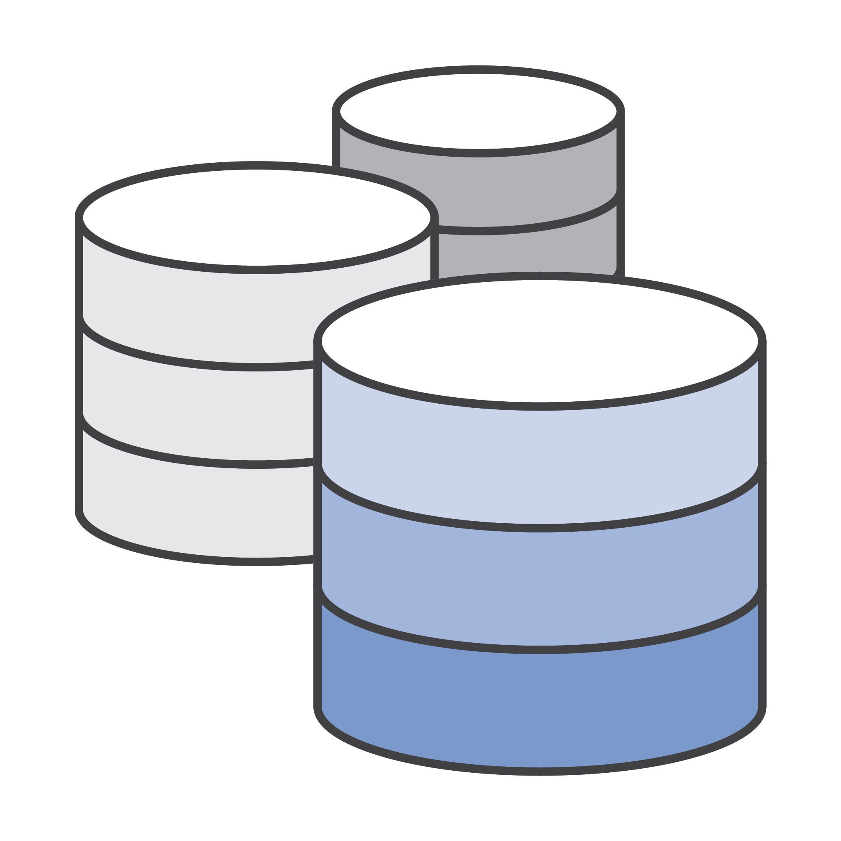
When to use DMS and SCT?
Replicate
Create cross-regions Read Replicas
Run your analytics in the cloud
Keep your dev/test and production environment sync
Modernize
Migrate
Modernize your database tier –
Commercial to open-source
Commercial to Amazon Aurora
Migrate business-critical applications
Migrate from Classic to VPC
Migrate data warehouse to Redshift
Upgrade to a minor version
Modernize your Data Warehouse –
Commercial to Redshift

Slide 15







DMS – Deployment
Replication Master
Replication Slave
Amazon S3
VPC subnet
VPC subnet
Availability Zone
Availability Zone

Slide 16
DMS – S3 as a Target
Bulk dump File
s3://mybucket/schemaName/tableName s3://mybucket/hr/employee
/schemaName/tableName/LOAD001.csv
/schemaName/tableName/LOAD002.csv
/schemaName/tableName/LOAD003.csv
...
101,Smith,Bob,4-Jun-14,New York 102,Smith,Bob,8-Oct-15,Los Angeles 103,Smith,Bob,13-Mar-17,Dallas 104,Smith,Bob,13-Mar-17,Dallas
Ongoing CDC Files
s3://mybucket/schemaName/tableName
<time-stamp>.csv
<time-stamp>.csv
<time-stamp>.csv
...
I,101,Smith,Bob,4-Jun-14,New York U,101,Smith,Bob,8-Oct-15,Los Angeles U,101,Smith,Bob,13-Mar-17,Dallas D,101,Smith,Bob,13-Mar-17,Dallas

Slide 17

Data Sources – Files, S3 as target
Files
Amazon S3

Slide 18
Transfer Files to S3
Optimizing Transfers
S3 Multi-Part Upload
S3 Transfer Acceleration
AWS Direct Connect
Available Services
AWS DataSync
AWS Transfer – SFTP
AWS Snowball/Snowmobile

Slide 19
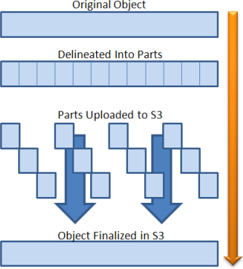
Uploading to Amazon S3
Amazon S3 supports both a single-part upload and a multi-part upload API
The single-part upload supports objects up to 5 GB in size
The multi-part upload supports objects up to 5 TB in size
The multi-part upload also enables you to maximize your throughput by using parallel threads
(!) Cleanup uploaded multi-part chunks in S3

Slide 20




S3 Transfer Acceleration
PUT requests go through the nearest AWS Edge Location
Data transits over the AWS private network rather than Internet
S3 bucket
AWS edge location
AWS private network optimizes throughput and latency to the AWS Region
Data is not stored in the edge cache
Uploader

Slide 21











S3 Access Points for shared Data sets
How Access Points Work
{
}
{
}
{ }
finance
accounting
sales
my-bucket.s3.amazonaws.com

Slide 22







Access Analyzer for S3
Quickly analyze resource policies across your entire AWS organization
Analyzes thousands of policies in seconds for public or cross- account access
Continuously monitor and analyze permissions
Continuously monitors and automatically analyzes any new or updated resource policy to help you understand potential
security implications
Provides the highest levels of security assurance
Uses automated reasoning, a form of mathematical logic & inference, to determine all possible access paths allowed by a resource policy

Slide 23
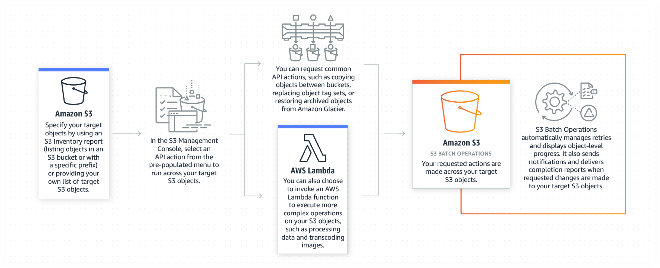
S3 Batch Operations
Manage billions of objects at scale, change object properties, perform storage management tasks

Slide 24











AWS Direct Connect
Virtual Private Cloud
EC2
Customer Gateway
VPC Endpoint
Customer/Partner Router
AWS Direct Connect Endpoint
Corporate Data Center
Customer/Partner
AWS Cage
Private Virtual Interface
Public Virtual Interface
Direct Connect Location
Amazon S3
AWS Region

Slide 25




AWS DataSync
Online transfer service that simplifies, automates, and accelerates moving data between on-premises storage and AWS
AWS
Fast data transfer
Easy to use
Secure and reliable
Cloud
integrated
Cost-
effective
Combines the speed and reliability of network acceleration
software with the cost-effectiveness of open source tools

Slide 26
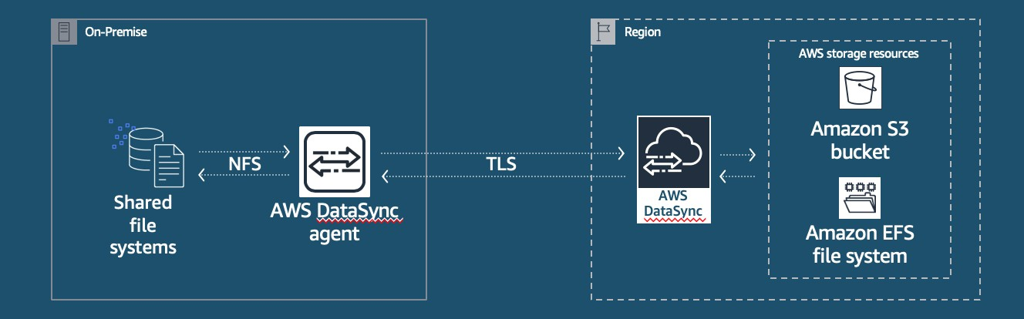



How AWS DataSync works
Deploy on- premises agent for fast access to local storage
Data transfer over the WAN using purpose- built protocol
Service in AWS writes or reads data from AWS storage services
Managed from AWS Console or Command Line Interface (CLI)

Slide 27






AWS Transfer for SFTP
Fully managed SFTP service for Amazon S3
Seamless migration of existing workflows
Fully managed in AWS
Secure and Compliant
Native integration with AWS services
Cost-effective
Simple to use

Slide 28














Setting up AWS Transfer
Map your hostname
Select your S3 bucket(s)
Set up your users
1
2
3
Your users can now use your AWS SFTP server endpoint to transfer data

Slide 29
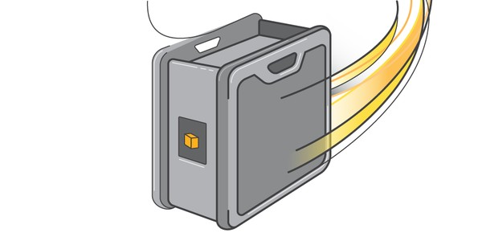
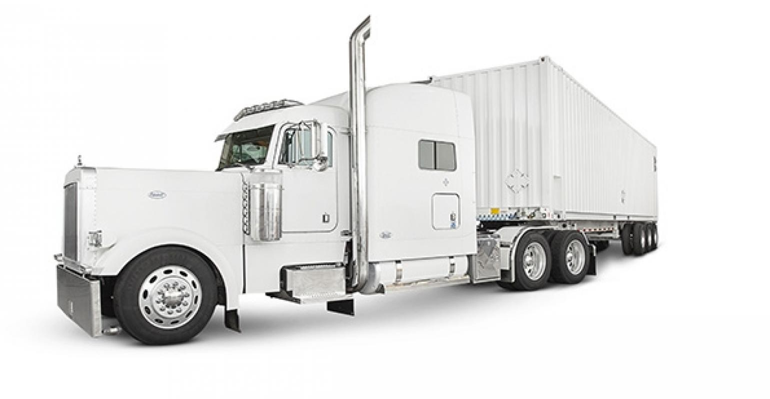
AWS Snowball/Snowmobile
Use Case | AWS Solution
Cloud Migration, Disaster Recovery | AWS Snowball
Internet of Things (IoT), Remote Locations | AWS Snowball Edge
Migrating Exabytes of Data | AWS Snowmobile

Slide 30

Data Sources - Streams
Stream
Amazon S3

Slide 31
Streams
Collecting and Analyzing
Amazon Kinesis
Amazon Managed Streaming for Kafka (MSK)
Example: Clickstream Analytics

Slide 32








Real-time Streaming on AWS
Easily collect, process, and analyze video and data streams in real time
Kinesis Data Streams
Kinesis Data Firehose
Kinesis Data Analytics
Amazon Managed Streaming for Kafka
Kinesis Video Streams
Collect and store data streams for analytics
Load data streams into AWS data stores
Analyze data streams with SQL or Java
Collect and store data streams for analytics
Capture and store video streams for analytics

Slide 33
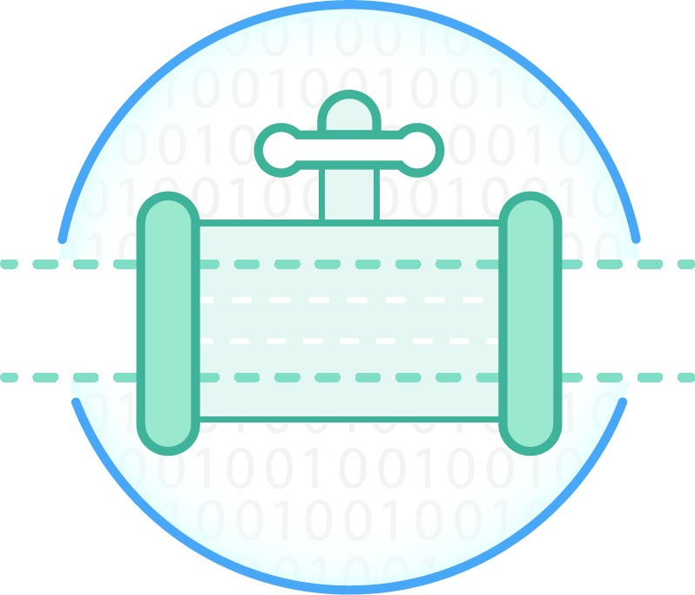


Amazon Kinesis - Stream Processing on AWS
Streams
Capture streaming data for downstream processing
Allow multiple processors to read streams at their own rate
Firehose
Buffer records in a stream into a single output for more efficient storage
Automatic flushing of buffer to S3, ElasticSearch, Redshift, or Splunk
Analytics
Create time windows over streams and perform aggregate operations using SQL
Join together multiple streams and output to new streams

Slide 34
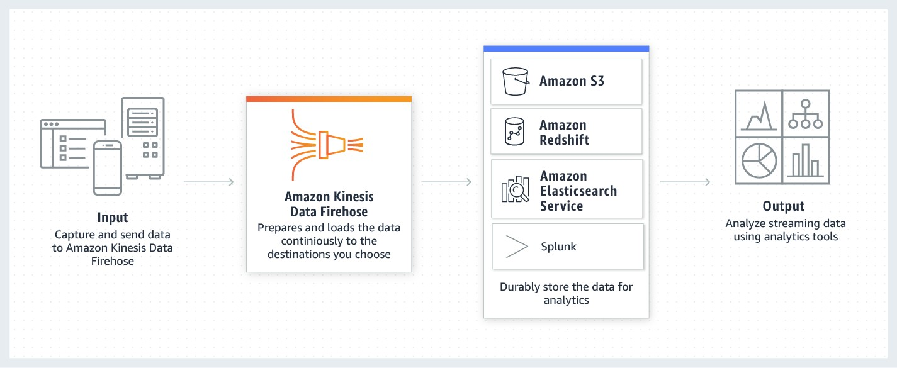
Amazon Kinesis Data Firehose
Zero administration and seamless elasticity
Direct-to-data store integration
Serverless continuous data transformations
Near real-time
Data format conversion to Parquet/ ORC
© 2020, Amazon Web Services, Inc. or its Affiliates.

Slide 35
Amazon Kinesis Data Firehose
Sources
Destinations
Direct PUT (from data producer)
Kinesis Data Streams
S3
Redshift
Elasticsearch Service
Splunk
Buffering
Time-based buffer: configurable from 1 min up to 15 mins
Volume-based buffer: configurable from 1 MB up to 128 MB (1-100MB for ES destination)
Buffer is flushed to destination upon either buffer threshold, whichever occurs first
Splunk destinations are buffered for 5MB or 1 min.

Slide 36

Amazon Kinesis Data Firehose
Data Transformation with AWS Lambda
Firehose buffers up to 3MB of ingested data
When buffer is full, automatically invokes Lambda function, passing list of records to be processed
Lambda function processes and returns list of transformed records, with status of each record
Transformed records are saved to configured destination
[{"
"recordId": "1234",
"data": "encoded-data"
},
{
"recordId": "1235", "data": "encoded-data"
}
]
[{
"recordId": "1234",
"result": "Ok"
"data": "encoded-data"
},
{
"recordId": "1235",
"result": "Dropped"
"data": "encoded-data"
}
]

Slide 37
Pre-Built Data Conversions
Save space and enable faster queries compared to row-oriented formats like JSON.
Convert the format of your input data from JSON to columnar data format
Apache Parquet or Apache ORC before storing the data in Amazon S3.
Works in conjunction to the transform features to convert other format to JSON before the data conversion

Slide 38









Stream Ingestion
Data from tens of thousands of data sources can be written to a single stream
AWS Toolkits/Libraries AWS Service Integrations 3rd Party Offerings
AWS SDK
AWS IoT
LOG4J
Kinesis Producer Library
Amazon CloudWatch Logs
Amazon CloudWatch Events
Flume
AWS Mobile SDK
Fluentd
Kinesis Agent
Amazon Database Migration Service (DMS)*
* Amazon DMS includes 8 on-premise databases, 1 Azure database, 5 RDS/Aurora database types, and S3

Slide 39
Amazon Kinesis – Streams vs Firehose
Amazon Kinesis Data Streams is for use cases that require custom processing, per incoming record, with sub-1 second processing latency, and a choice of stream processing frameworks
Amazon Kinesis Data Firehose is for use cases that require zero
administration, ability to use existing analytics tools based on Amazon S3,
Amazon Redshift, and Amazon ES, and a data latency of 60 seconds or higher

Slide 40





Kinesis Data Streams – Lots of Integrations
Sending
Consumin g
Get* APIs
Kinesis Data Streams
Put* APIs
Kinesis Producer
Library
AWS
Mobile SDK
LOG4J
Kinesis Consumer Library
AWS Lambda
Amazon Elastic MapReduce (EMR)
Apache Storm
Flume
Fluentd
Apache Spark

Slide 41
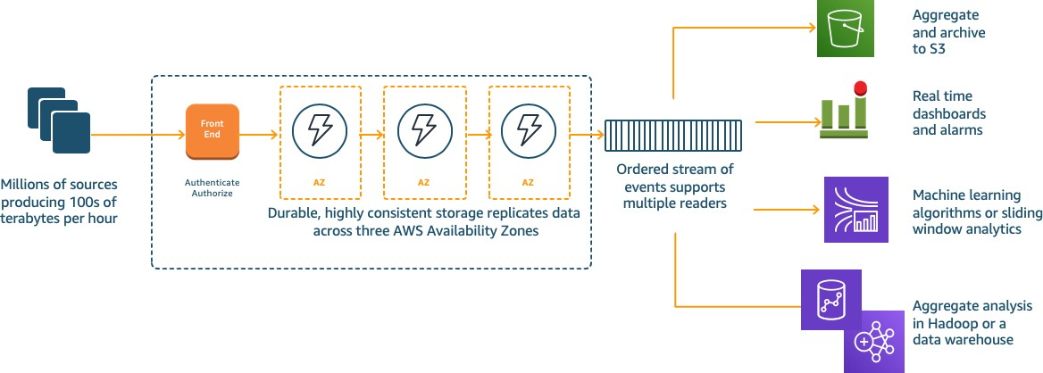
Kinesis Data Streams – How it works

Slide 42
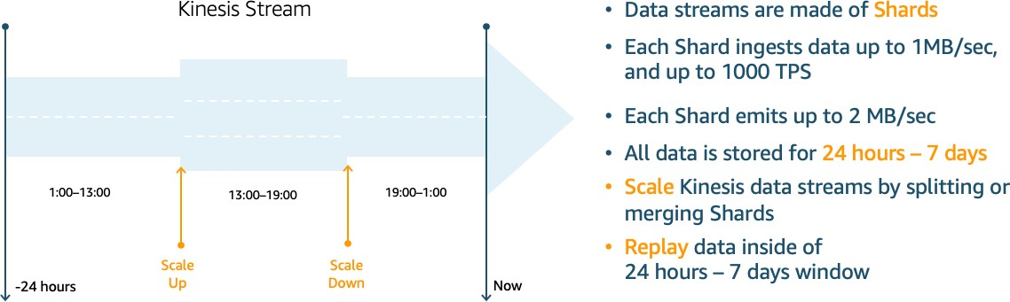
Kinesis Data Streams – How it works cont.

Slide 43
Amazon Managed Streaming for Kafka (MSK)
Fully compatible with Apache Kafka v2.6.0 (and some other 2.x versions)
AWS Management Console and AWS API for provisioning
Clusters are setup automatically
Provision Apache Kafka brokers and storage
Create and tear down clusters on-demand

Slide 44










Comparing Amazon Kinesis Data Streams to MSK
Amazon Kinesis Data Streams
Stream with 3 shards
Amazon MSK
Topic with 3 partitions
0
1
2
3
4
5
Shard 1
0
1
2
3
4
5
Partition 1
Writes from Producers
Writes from Producers
0
1
2
3
Shard 2
0
1
2
3
Partition 2
0
1
2
3
4
Shard 3
0
1
2
3
4
Partition 3
Oldest data
Newest data
Oldest data
Newest data

Slide 45
Comparing Amazon Kinesis Data Streams to MSK
Amazon Kinesis Data Streams
AWS API experience
Throughput provisioning model
Seamless scaling
Typically lower costs
Deep AWS integrations
Amazon MSK
Open-source compatibility
Strong third-party tooling
Cluster provisioning model
Apache Kafka scaling isn’t seamless to clients
Raw performance

Slide 46












Clickstream with Real-Time Analytics
Conversion Rates
Anomalies
SNS
Lambda
Kinesis Data Stream
Kinesis Data Analytics
Kinesis Data Stream
API Gateway
Kinesis Data Firehose
Amazon S3
Kinesis Data Firehose

Slide 47






Clickstream with Spark on EMR
Conversion Rates
Kinesis Data Firehose
Kinesis
API Gateway _{Data Stream}
Spark on EMR
Kinesis Data Firehose
Amazon S3

Slide 48

Data Sources - Logs
Logs
Amazon S3

Slide 49
Logs
Collecting and Analyzing
Amazon CloudWatch
Amazon Kinesis
Other Options

Slide 50






Logs – CloudWatch Agent
CloudWatch Log Stream
AWS Lambda
Amazon S3
EC2 Instances

Slide 51








Logs – Kinesis Agent
Kinesis Data Firehose
Amazon S3
EC2 Instances with Kinesis Agent

Slide 52











Logs – Kinesis Agent (with Analytics)
Kinesis Data Analytics Kinesis Data Firehose
Kinesis Data Stream
Amazon S3
EC2 Instances
Kinesis Data Firehose

Slide 53
Logs - Other Options
Use OSS agents, like Flume or Fluentd
Pre-batch PUTS for better efficiency
See https://github.com/awslabs/aws-fluent-plugin-kinesis
Make a tweak to your existing logging
log4j appender option
See https://github.com/awslabs/kinesis-log4j-appender

Slide 54







Summary – Ingestion into S3 (Data Lake)
s3://datalake/
/vendorfeeds
/vendorA
/vendorB
/clickstream
/orders
/vendors
/customers
/app_logs
/instance1
/instance2
/syslogs
/instance1
/instance2
/databases
/customers
/orders
/vendors
AWS DataSync
Files
API Gateway
Streams
Direct Put
Amazon S3
Kinesis Data Firehose
Logs
Kinesis Agent
DMS
Databases

Slide 55























Options for data transfer
AWS
Direct Connect
Amazon Kinesis Data Firehose
Amazon Kinesis Data Streams
Amazon Kinesis Video Streams
Amazon S3 Transfer Acceleration
AWS
Storage Gateway
AWS
Snowball
AWS
Snowball Edge
AWS
Snowmobile
AWS
DataSync
AWS
Transfer for SFTP

Slide 56
Thank you!

